Slide 1
Predictive modeling
Presented by : Jyoti Devi

Slide 2
Task DESCRIPTION
In this task, I will build a predictive model using a given dataset to predict a target variable using supervised learning algorithms such as decision trees, logistic regression, and random forests to build the model.
We will Build a predictive model to predict the math score of a student based on other variables such as gender, race/ethnicity, parental level of education, lunch, and test preparation course.

Slide 3
DATASET
The dataset is provided by Hackveda and this dataset contain the information of student.
We can download the dataset from here :
https://www.kaggle.com/spscientist/students-performance-in-exams

Slide 4

GOAL
THE GOAL OF THIS PROJECT IS TO PREDICT THE STUDENT'S MATH SCORE BASED ON OTHER PARAMETERS.

Slide 5
Steps to achieve this goal :
Step-1 Analyse and visualise the data
Step-2 Load the dataset
Step-3 Separate the feature and label value
Step-4 Split the data in the ratio of 80:20 for training and testing.
Step-5 Train the data with the particular model.
Step-6 Get the accuracy score of each model.
Step-7 Select the best model with high accuracy.

Slide 6
Feature values
After analysis the dataset we got some feature values on which the students's math score depends.
1. gender
2. Race/ethnicity
3. parental level of education
4. Lunch
5. test preparation course
6. reading score
7. writing score

Slide 7
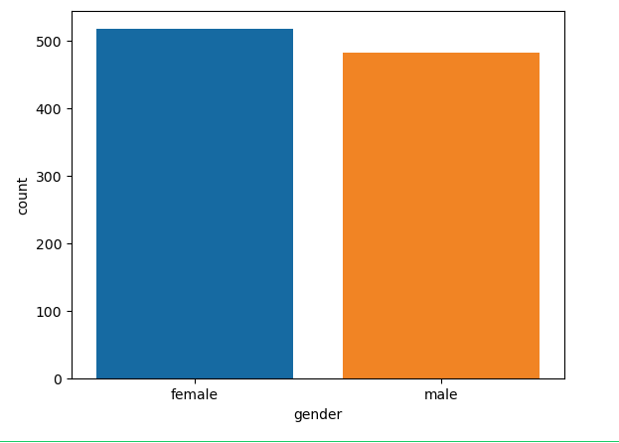
Data Visualisation
Checking the gender column is balance or not?

Slide 8
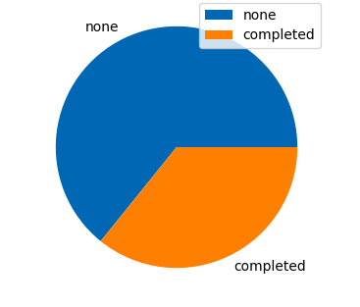
Data Visualisation
Checking How many of the students took course.
Significantly more students didn't take course

Slide 9
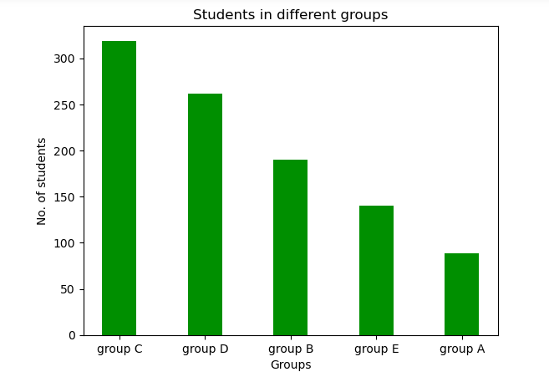
Data Visualisation
No. of students in each group

Slide 10
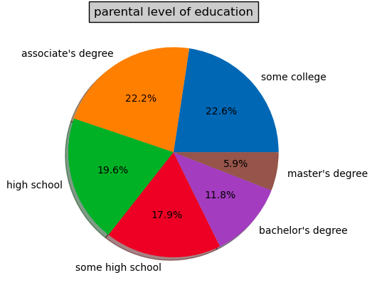
Data Visualisation
Parental education

Slide 11
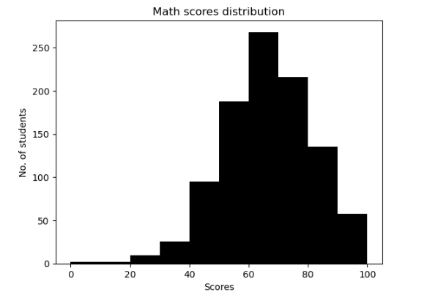
Data Visualisation
Scores distribution visualization by histogram

Slide 12
Steps to get best result
Split
  split data for testing and training
Train
  train the models on training data
Accuracy
  check accuracy model accuracy by testing data

Slide 13

Machine learning algorithms used
random forest model
2. Logistic Regression
3. Linear regression

Slide 14
Accuracy of each model
Linear regression model : 88.38026201112224%
Random forest model : 84.89196832714583 %
Logistic Regression model : 67.54519631919993 %

Slide 15
Conclusion
The accuracy of linear regression model is more as compare to random forest and logistic regression model so, Linear regression model is more suitable for the given dataset.

Slide 16

Thank you!!

